Slide 1
Ways of Knowing
Do you think the following statements are TRUE or FALSE*?
We can believe in either Science or the Bible but not both.
We can learn about God through the world that He Created.
The Creation stories in Genesis are scientifically accurate.
The Catholic Church opposes the theory of evolution.
God’s self-communication is called Divine Revelation.
Notes:
*Adapted from Revelation and the Old Testament: Live Jesus in Our Hearts. 2019. Saint Mary’s Press.
Students will answer these T/F questions in the guided notes packet. Discuss.

Slide 2

How do we know?
observation
A trustworthy person told me so…(BELIEF)
FAITH
REASON
Empirical evidence
God tells us (Revelation)
Math
Faith and reason are like two wings on which the human spirit rises to the contemplation of truth.
-Fides et Ratio.
-Pope Saint John Paul II
Logic
Notes:
Leading from the T/F questions, we go into “How do we know about God? These notes will be taken in the guided notes packet. Fides et Ratio.

Slide 3

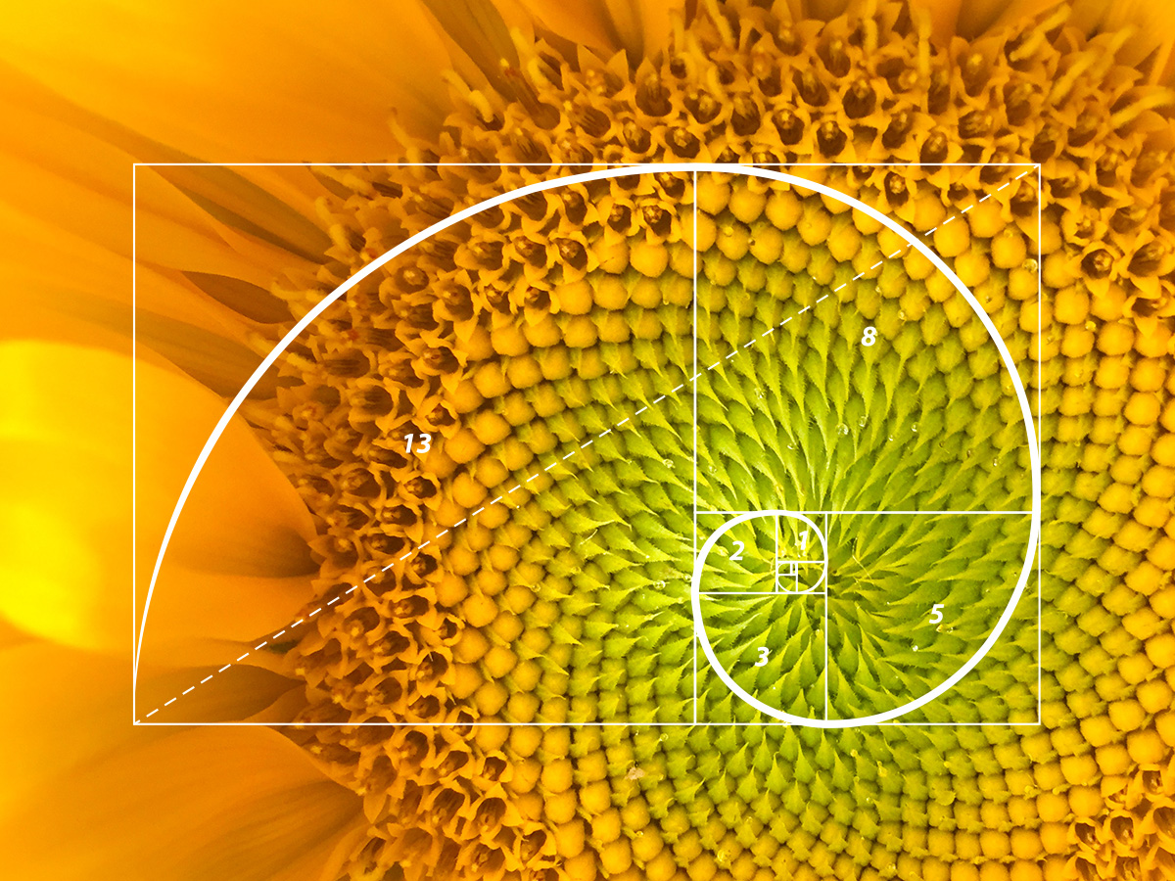
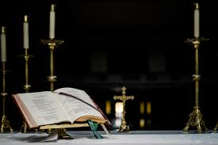
Revelation
Natural Revelation: Knowing about God from observing nature and using reason.
Divine Revelation: God making himself known in the Scripture and Tradition of the Church.

Slide 4
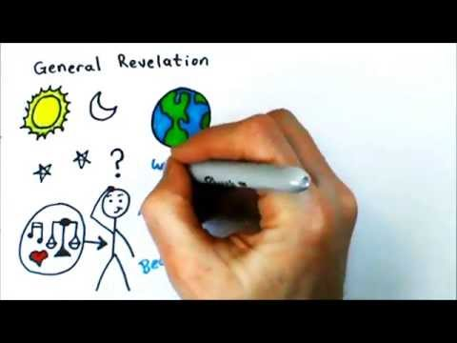
Natural Revelation and Divine Revelation

Slide 5
What is the nature of science?
Science is a body of knowledge based on the study of nature.
Uses evidence to construct testable explanations and predictions of natural phenomena
Scientific inquiry is both a creative process and a process rooted in unbiased observations and experimentation
New scientific ideas are generated by curiosity, skepticism, open-mindedness, and creativity

Slide 6
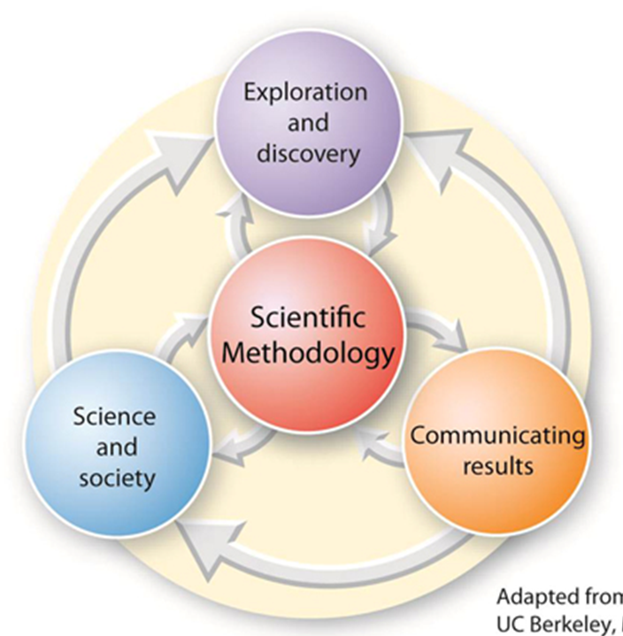

Slide 7
What Science Does
Most scientific fields are guided by research that results in a constant reevaluation of what is known
Science aims to investigate and explain the natural world and make useful predictions
Science relies on testing explanations
Often times, science comes to conclusions through disproving things rather than proving things.
science vs pseudoscience

Slide 8
The Scientific Method:
Scientific inquiry starts with asking questions and processing information from a variety of sources
It follows with forming a hypothesis: a TESTABLE explanation for a set of scientific observations
After a hypothesis is formed, a controlled experiment(s) is designed
The data is then collected and analyzed, often using statistical methods
The results are then collected into a scientific report which is subjected to peer review before publication for other scientist to critique and evaluate

Slide 9
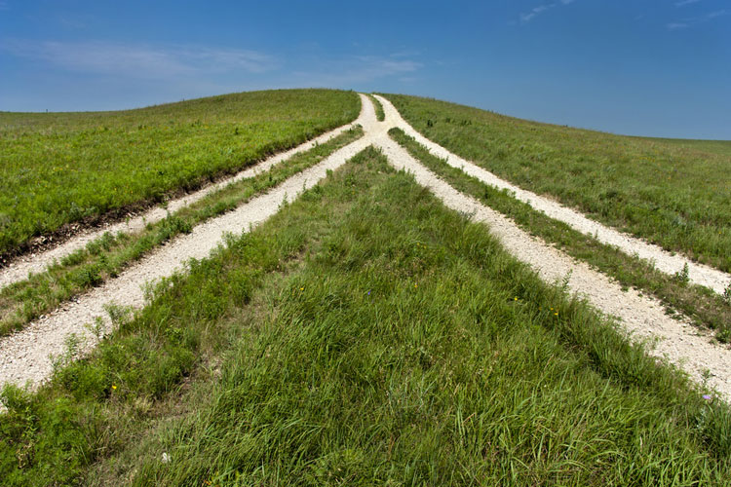
TWO WAYS OF KNOWING
TRUTH
SCIENCE:
Laws of Nature
Natural World
Observable
Measureable
How???
FAITH:
Religious Truth
Why???
Cannot be objectively measured

Slide 10
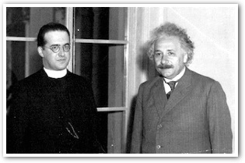
“I was interested in truth from the point of view of salvation just as much as in truth from the point of view of scientific certainty. It appeared to me that there were two paths to truth, and I decided to follow both of them.”
- Fr. Georges Lemaître, S.J.
Developer of the Big Bang Theory
Photo of Lemaître and Einstein, 1933

